Slide 1
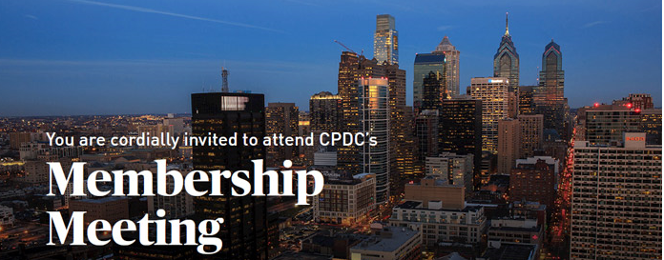

Tuesday, April 25, 8:30 AM
State of Center City 2017
Attracting More Businesses Downtown
Lisha Davis Innovation Strategy, Vanguard
John Grady President, PIDC
Wayne L. Fisher Ex Managing Director, Newmark Grubb Knight Frank

Slide 2
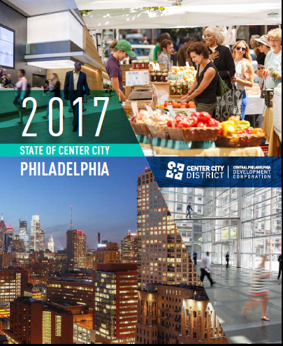
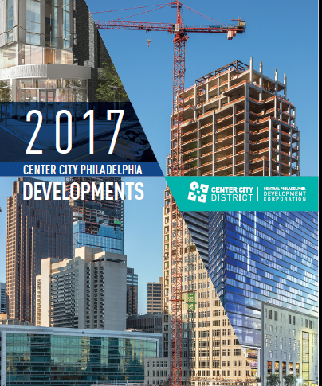
Today: releasing two related documents

Slide 3
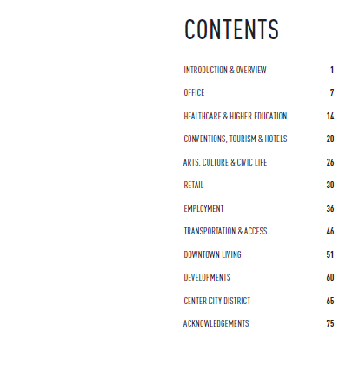
State of Center City report
Comprehensive overview of downtown marketplace in 10 chapters

Slide 4
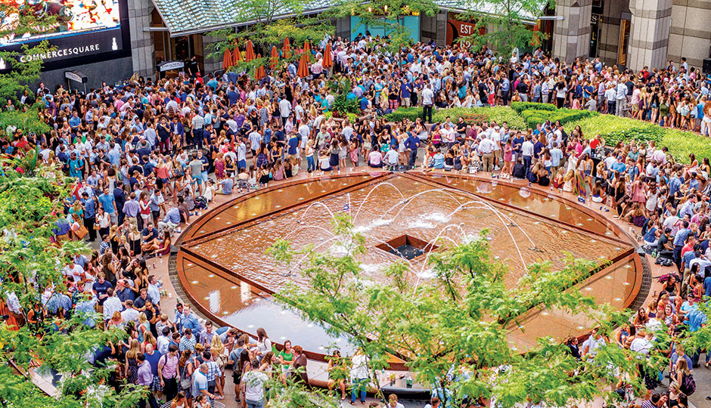
Each chapter contains reasons for celebration
Outlines challenges to overcome

Slide 5
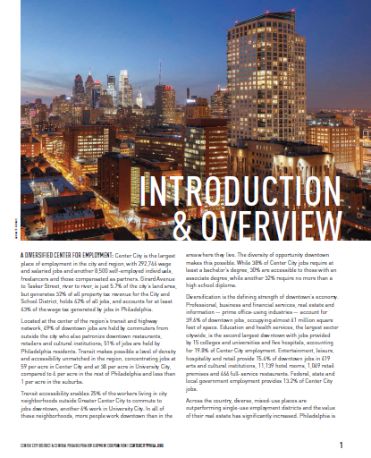
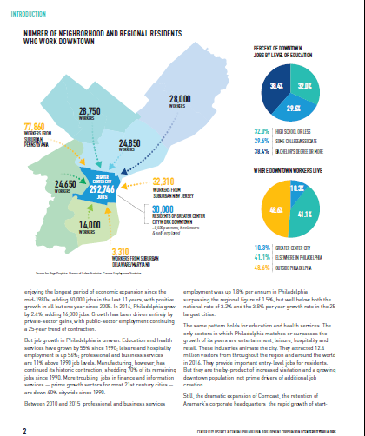
If you have limited time, you can read 6 page Introduction & Overview

Slide 6

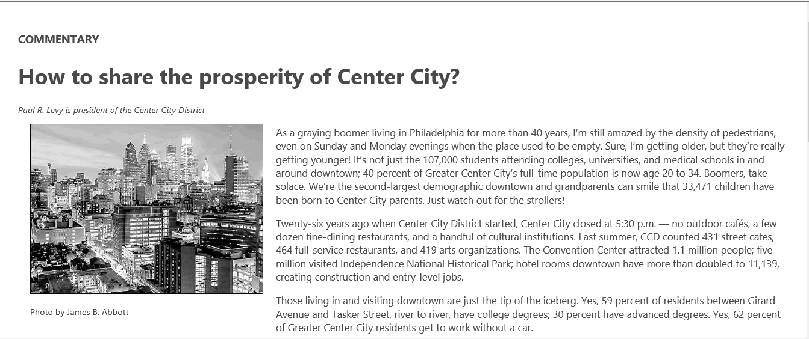
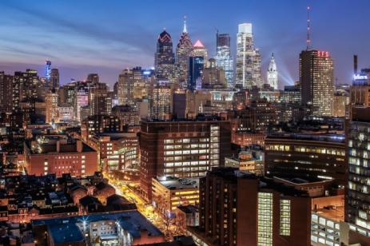
If you are you really lazy
You can read print or online summary in 800 words

Slide 7
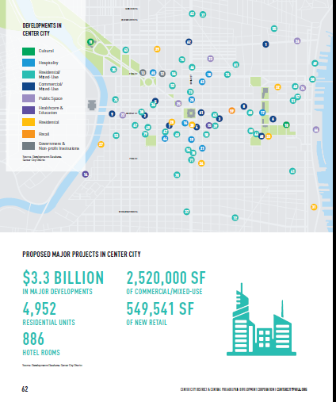
2017 Developments
Profiles 42 major projects underway; $5.4 billion

Slide 8
Multi-month, team effort led by
Nancy Goldenberg, VP of Planning & Development
Jack Denison, Research Assistant
Casandra Dominguez, Manager, Business Retention & Retail Attraction
Francisco Garcia, Research Assistant
Linda Harris, Director of Communications & Publications
Garret Hincken, Senior Manager of Research & Transportation Policy
Bonnie Thompson, Director, Web Development & Interactive Marketing
R.J. White, Manager of Interactive Marketing
Report was designed by
Amy Yenchik, Creative Director
Michael Choi
Tran La

Slide 9
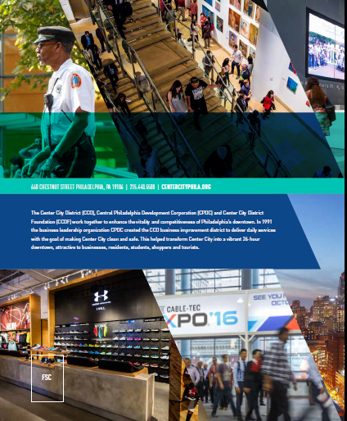
State of Center City 2017

Slide 10
Downtown: setting for 42% of all jobs in Philadelphia

Slide 11
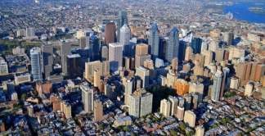
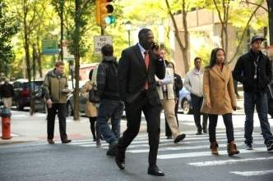

Most diversified employment center in the region
40% office, 20% eds/meds; 13% public sector 16% leisure, hospitality, retail

Slide 12
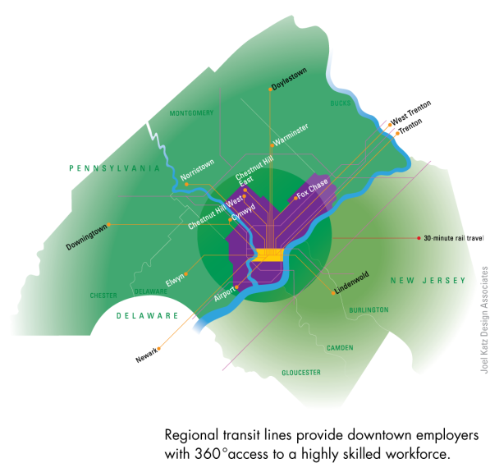
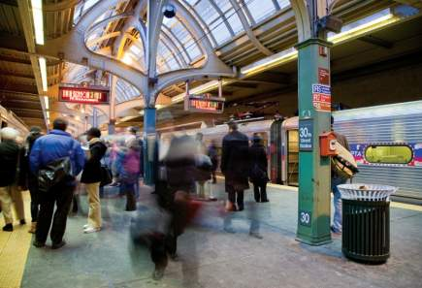
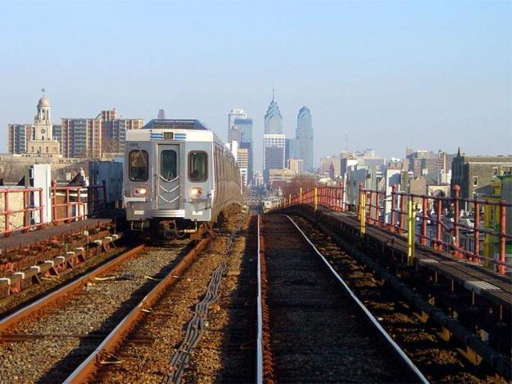
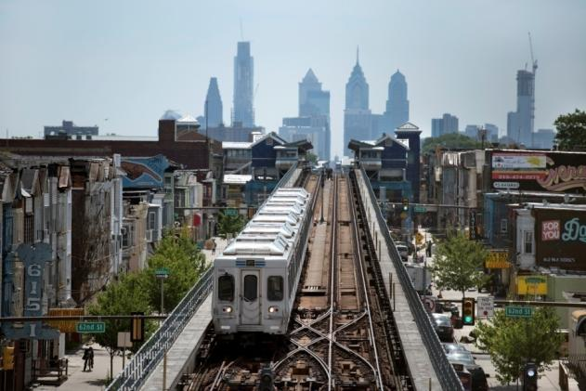
Well-served by a regional transit system brings
310,000 riders/day into downtown

Slide 13
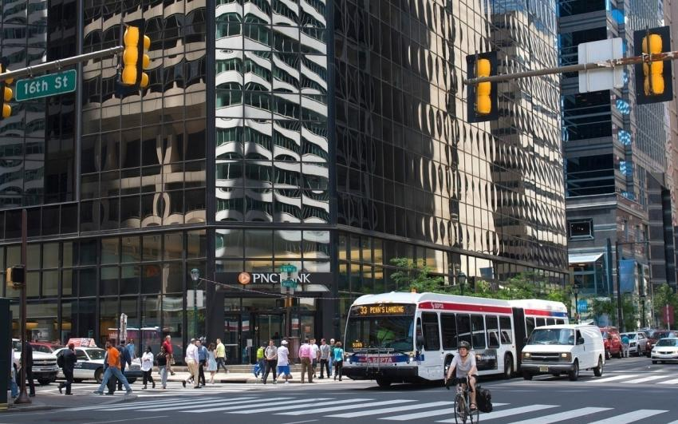
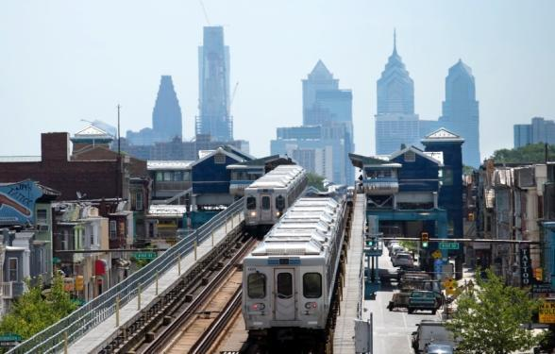
Transit makes possible dense concentration of jobs

Slide 14
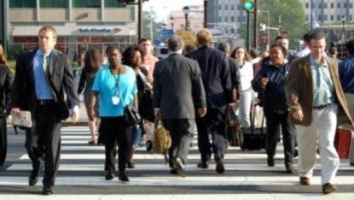
Place that provides job opportunities at all skill levels

Slide 15
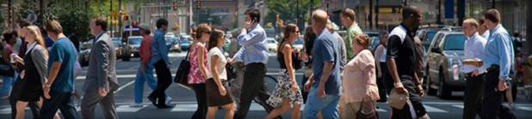
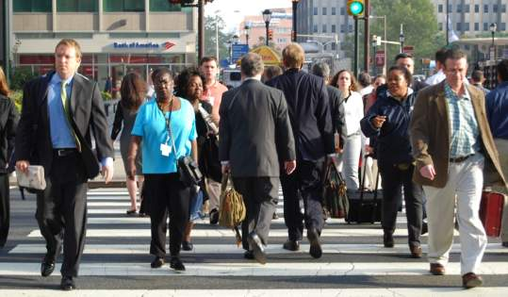
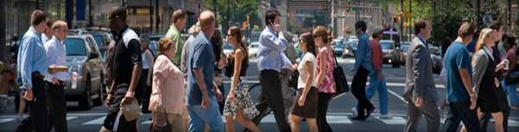
Residents from every city neighborhood & across the region
Work downtown (25% of each neighborhood)

Slide 16
Sustained period of job growth, added jobs for 11 of the last 12 years
Best run in the last 40 years

Slide 17
2016 was a very good year: first time in an up-cycle we outperformed our suburbs

Slide 18
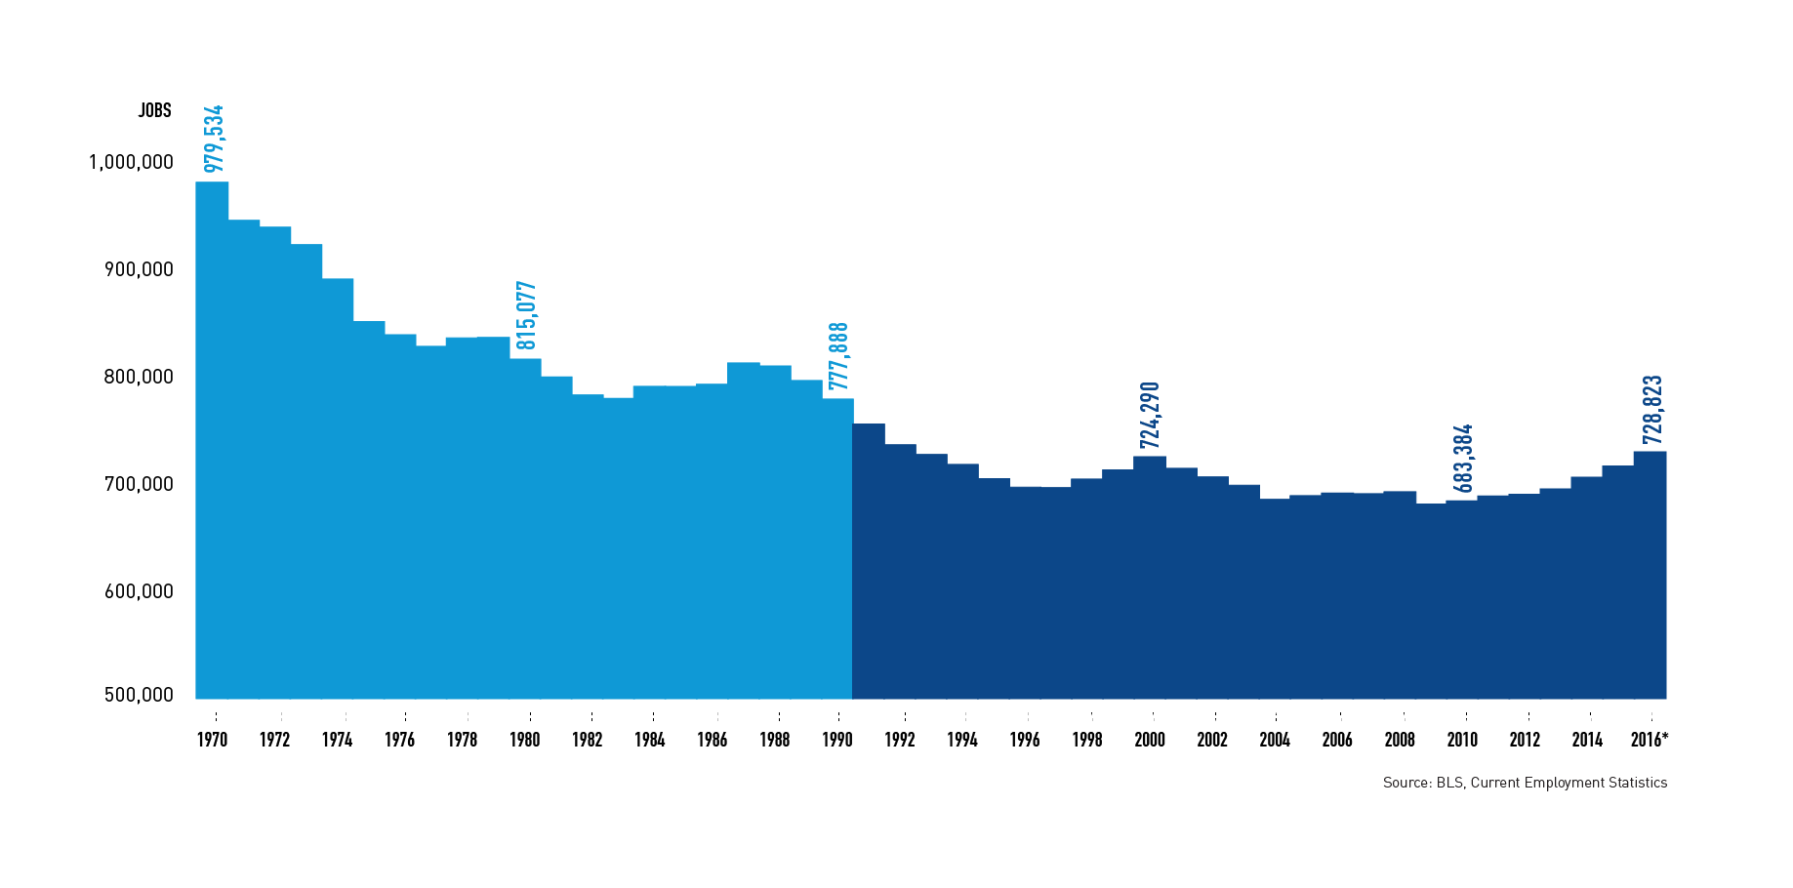
But: digging out from a long-period of job decline
Philadelphia has 27% fewer jobs than in 1970
Industrial decline
& suburbanization

Slide 19
Nationally, we’re in the midst of an urban led economic recovery

Slide 20
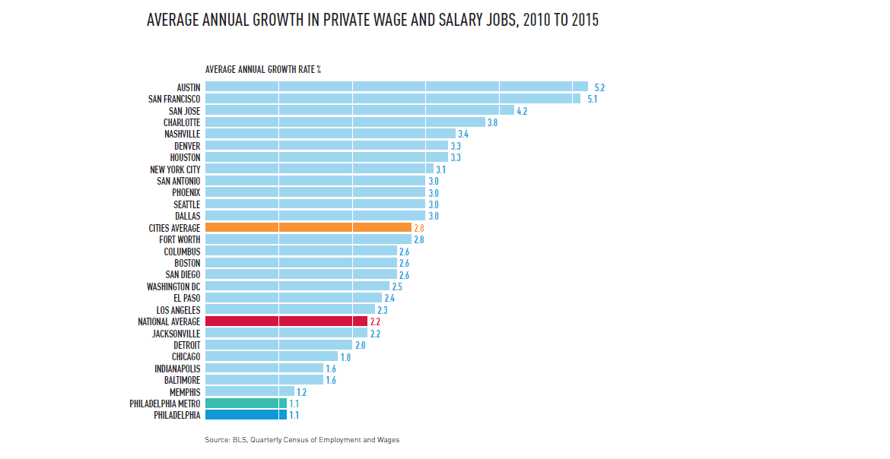
Cities are growing fast everywhere
25 largest cities all grew faster than Philadelphia 2010-2015
Nation grew at 2.2%/year
25 largest cities 2.8%/year
Philadelphia 1.1%/year

Slide 21
Philadelphia has rebounded from Recession
But not yet regained private sector job levels of 1990

Slide 22
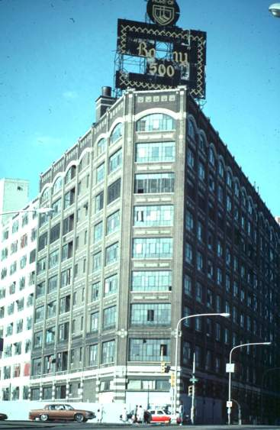
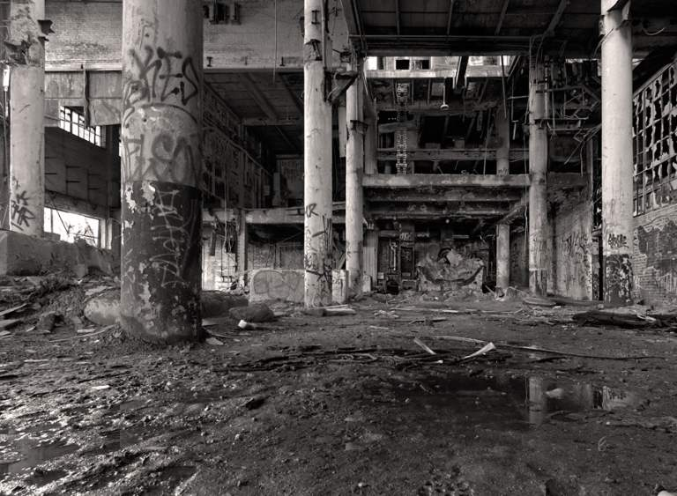
Our peer cities: Boston, New York & Washington DC
All lost 85%-90% of manufacturing jobs they held in 1970

Slide 23
But they surpassed their 1970 levels with new jobs while Philadelphia is down 25%; similar to Detroit

Slide 24
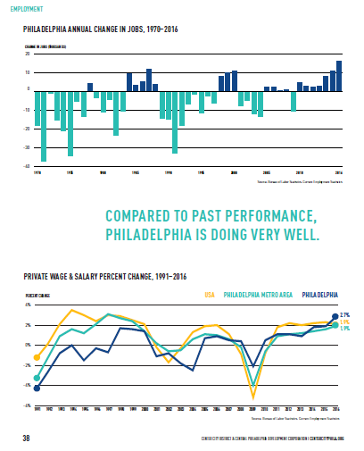
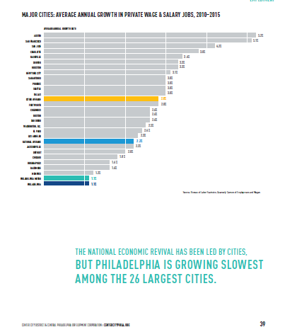
Whole story in the employment section: pages 38 & 39
Imagine we are in a race: looking in our rear-view, we’ve come really far
But looking out the side windows, our peers are passing us by

Slide 25
One of the highest poverty rates among major cities
+ High unemployment levels
City | % Below Poverty Line
Philadelphia, PA | 26.7%
Baltimore, MD | 23.6%
Boston, MA | 22.6%
New York City, NY | 20.9%
Washington, DC | 17.7%

Slide 26
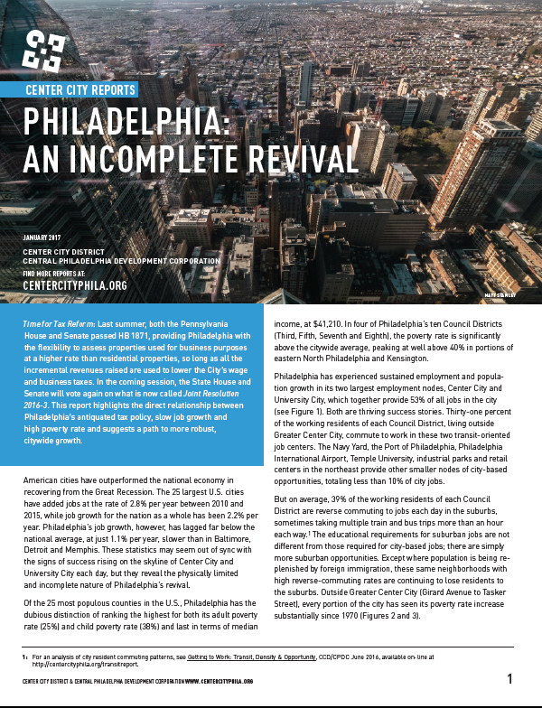
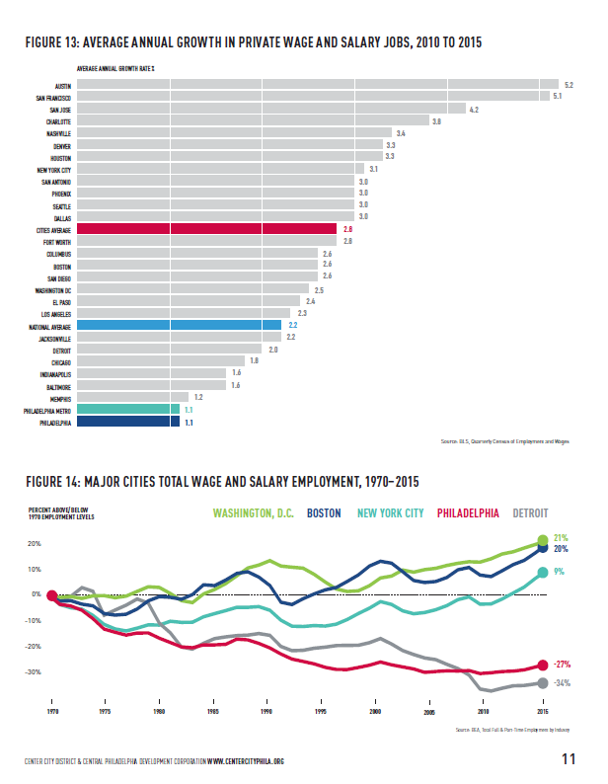
Challenge of Incomplete Revival

Slide 27
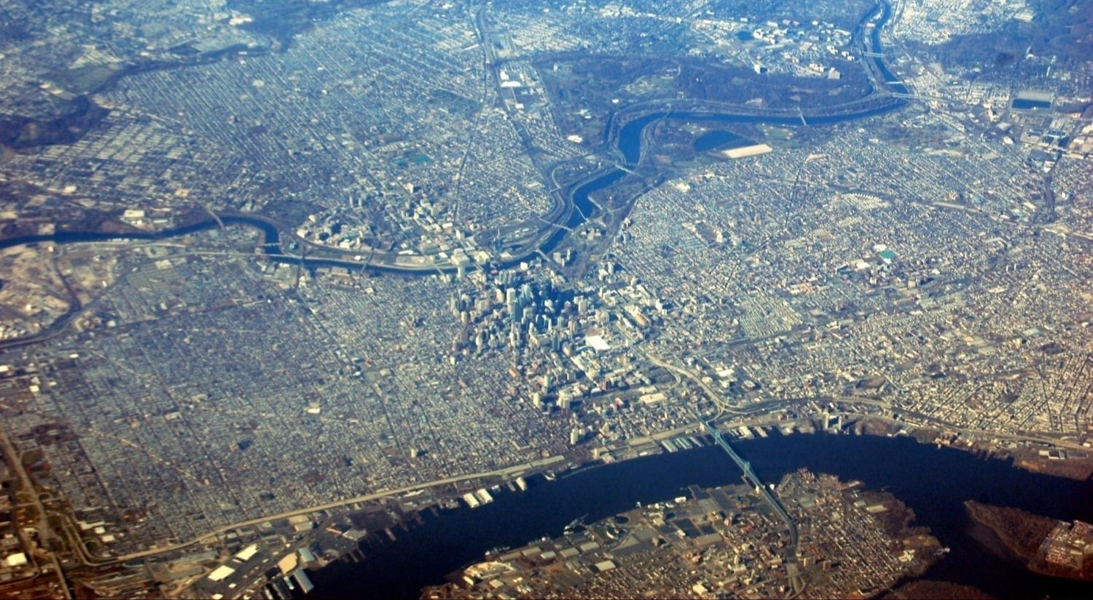
The renewal of Center City & University City
not big enough to offset citywide industrial decline

Slide 28
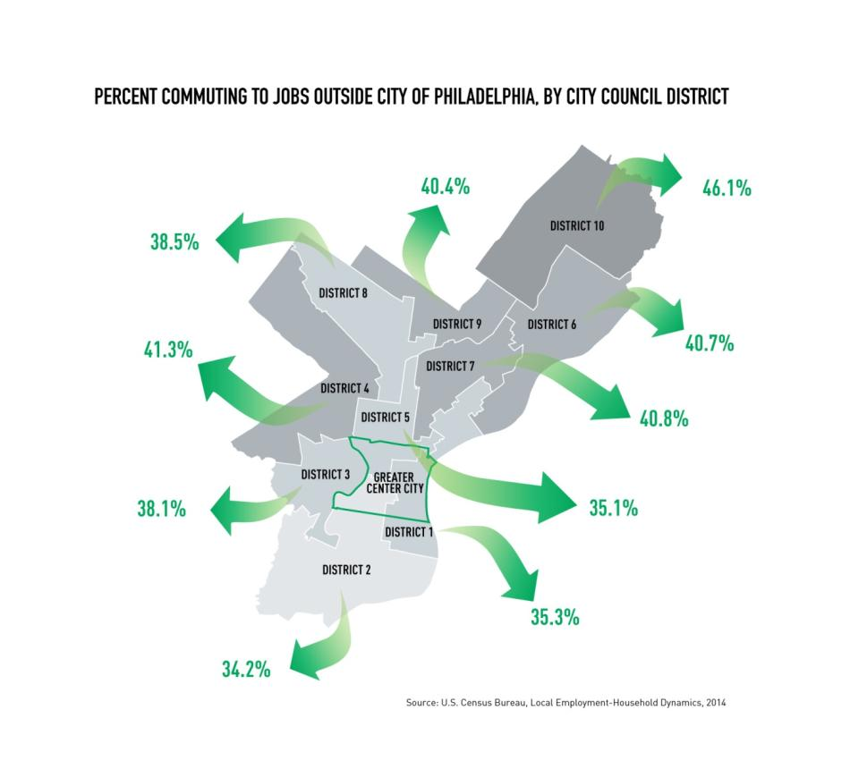
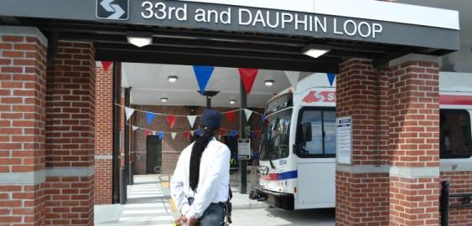
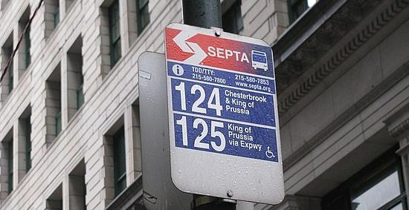
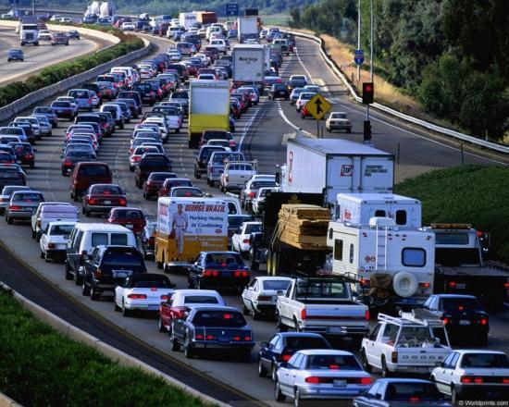
Outside Center City 225,000 Phila. residents (39% of workforce) Reverse commute to suburbs each day
By contrast only 15.3% of NYC residents commute to suburbs

Slide 29
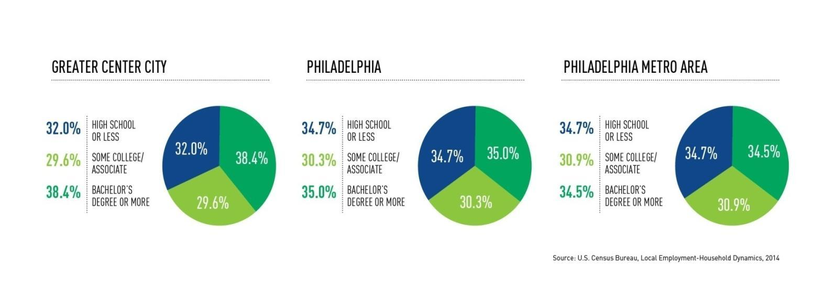
Little difference between level of education required by jobs
In Center City, Philadelphia & surrounding region

Slide 30
Suburbs have simply grown more jobs
Philadelphia still 6% below 1990 job levels

Slide 31
Uneven job growth: Eds & Meds + 50.5% citywide since 1990 Lower wage leisure & hospitality + 51.2%.
But office industries down 23% in the last 25 years

Slide 32
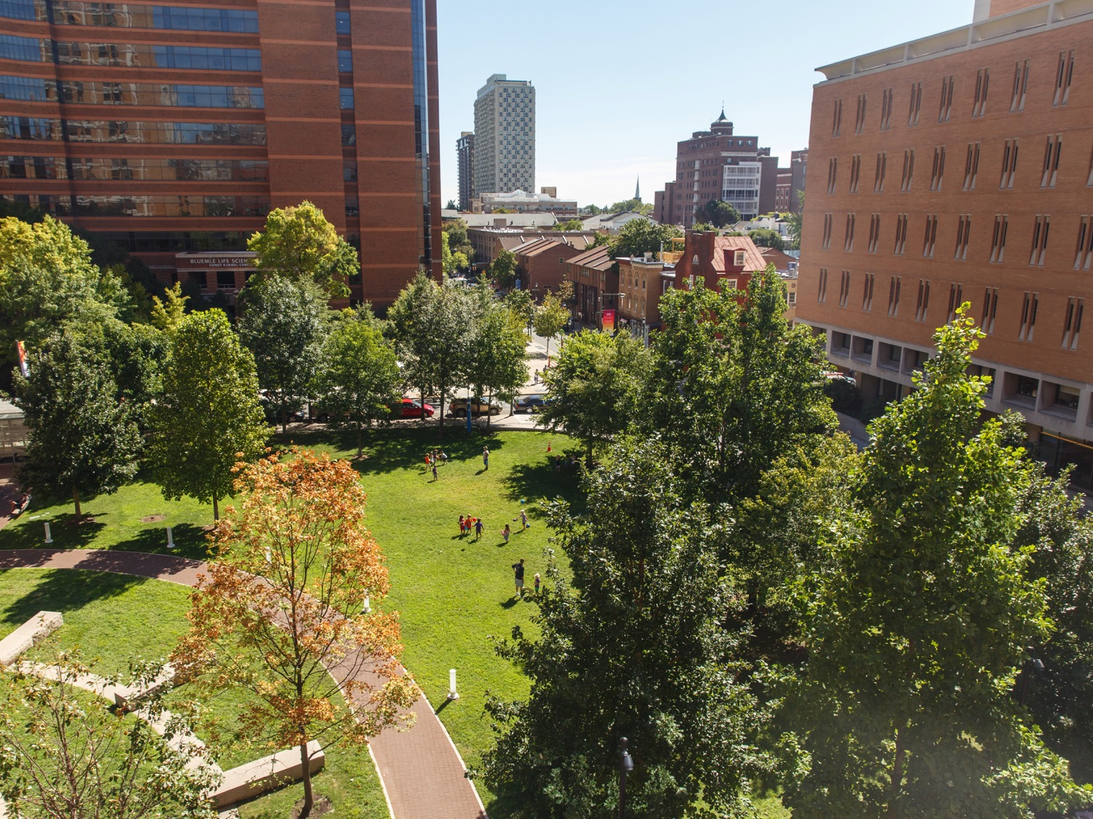
Healthcare &
Higher Education

Slide 33
58,000 eds & meds jobs in Center City

Slide 34
32,500 students + 75,431 adjacent = 107,000 students

Slide 35
$857 million in NIH grants
Major investments in innovation & the next economy

Slide 36
Patent applications up 38% to 330

Slide 37
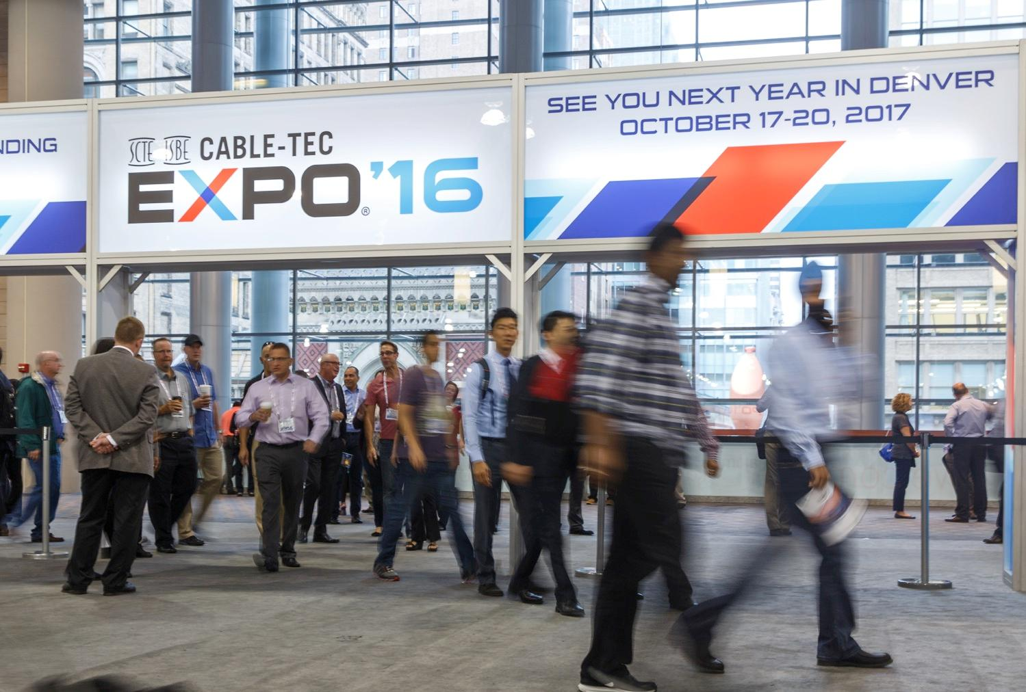
Conventions, Tourism & Hospitality

Slide 38
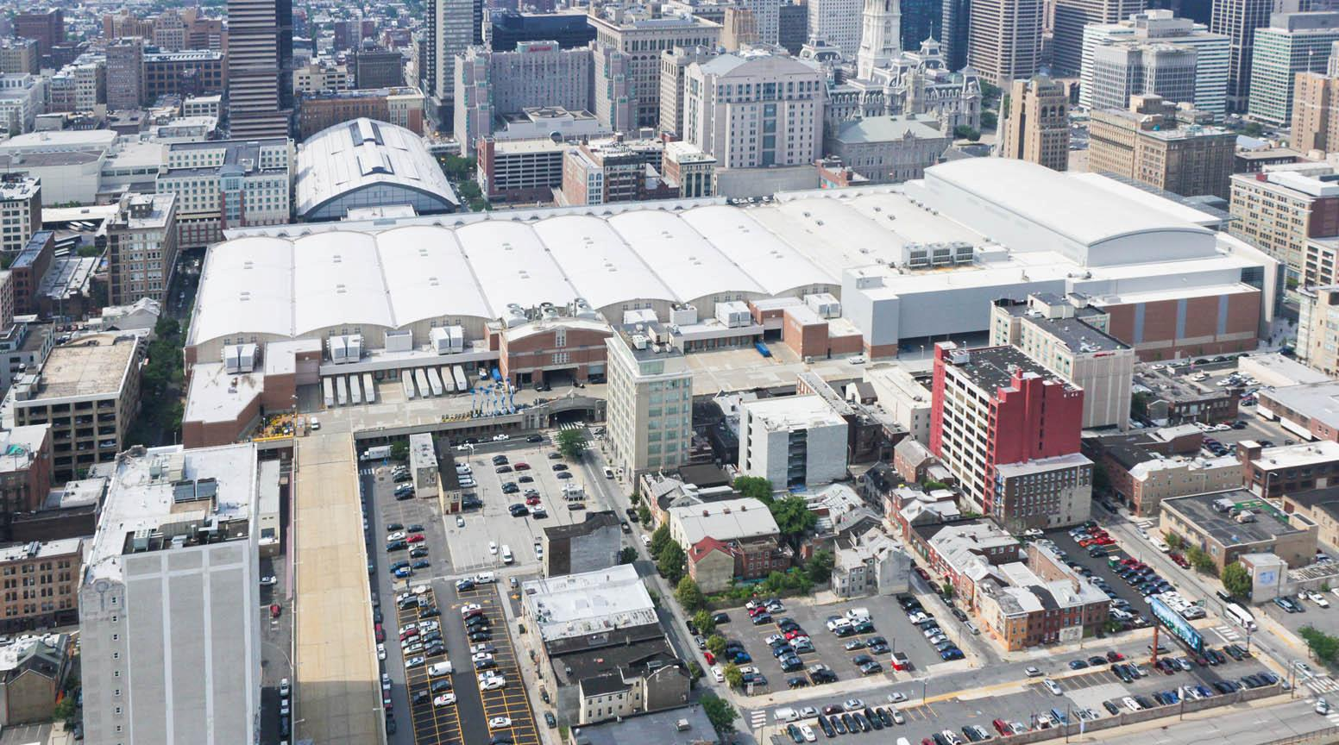
Steady growth in conventions & trade shows
1.1 million attendees in 2016

Slide 39
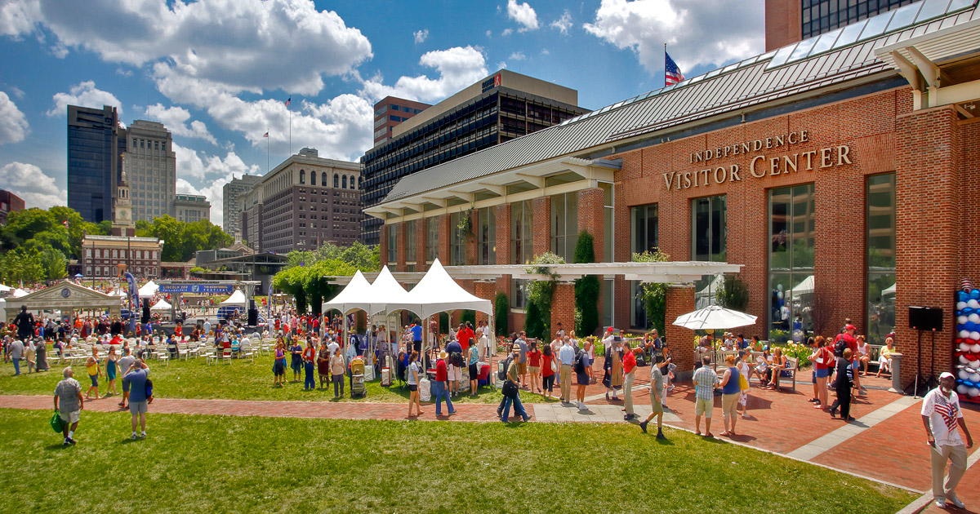
Record 5 million visitors at Independence National Historical Park

Slide 40
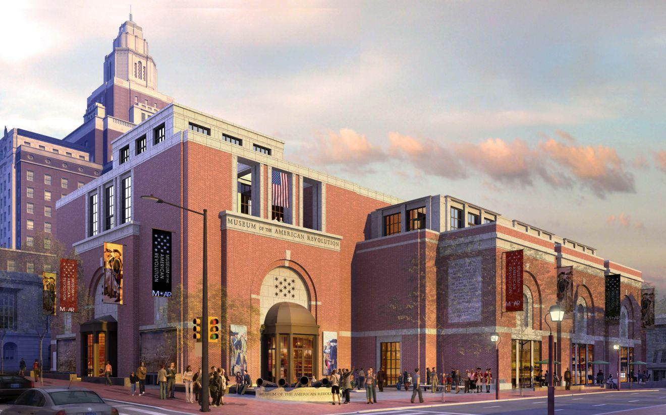
New facilities coming on line

Slide 41
Hotel room supply more than doubled: 11,139
78% occupancy rate

Slide 42
Significant supply of hotel rooms under construction

Slide 43
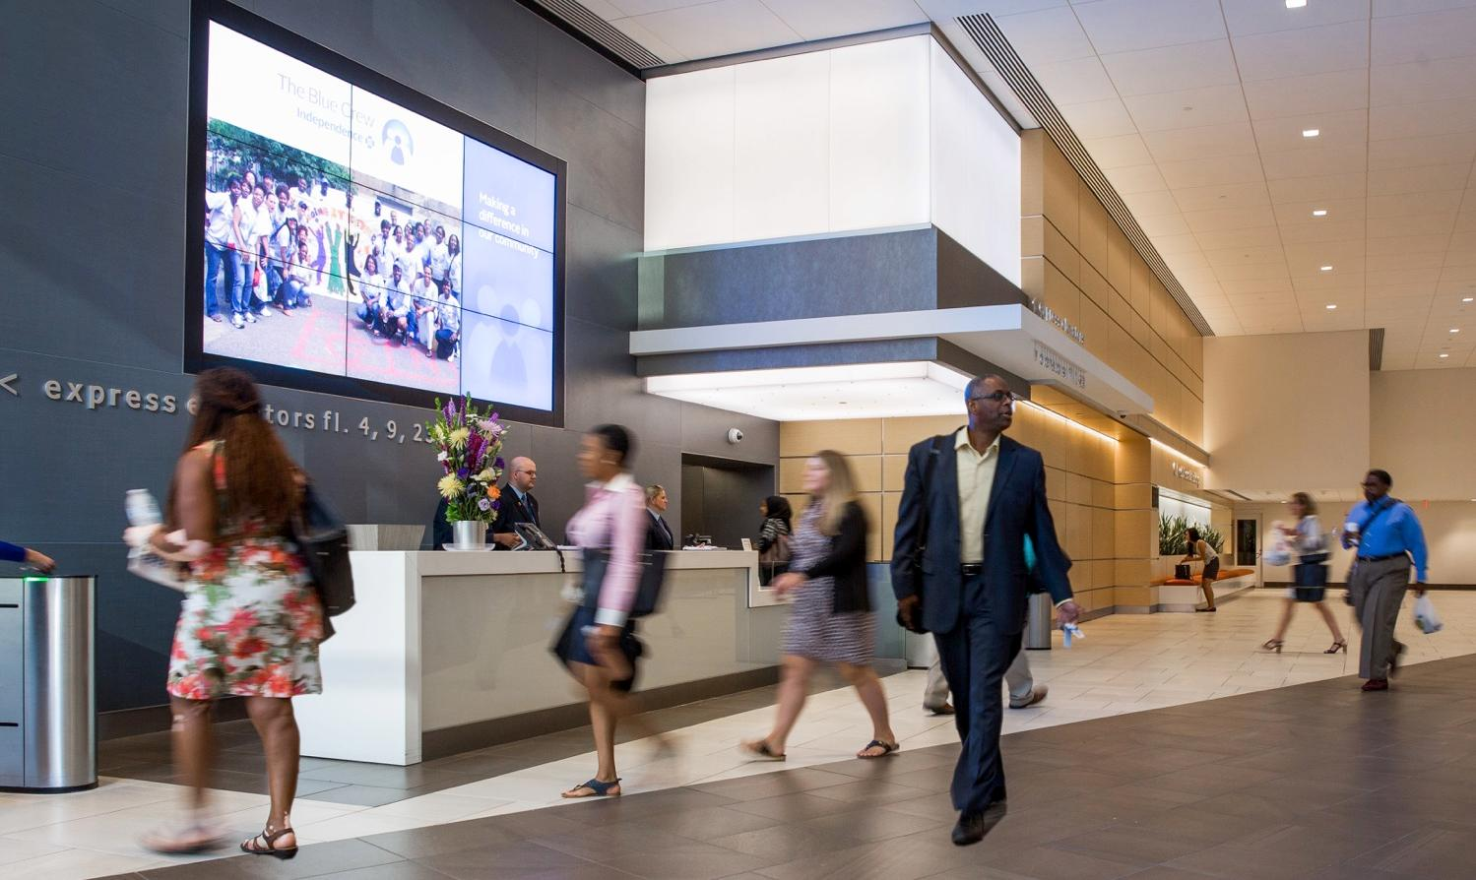
Office: largest sector of employment downtown = 40% of all jobs

Slide 44
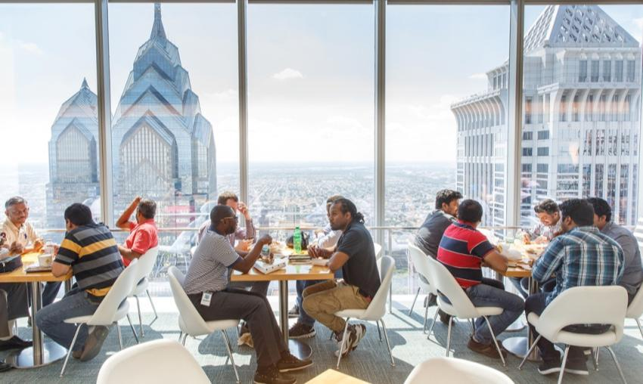
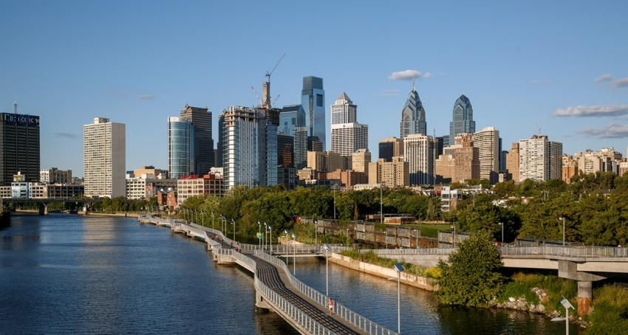
Office buildings hold densest concentration of jobs; Highest wage jobs; most diverse jobs; biggest multiplier effects
Every 500,000 square feet of occupied office space:
Provides 3,333 jobs + 5 building engineers 18 cleaners/janitors 12 security positions.
Every time tenants turn over, construction trades renovate space.
Supports 11,000 hotel rooms filled with business travelers.
Generates $2.8 million in retail demand.
Adds 2,333 riders to SEPTA.

Slide 45
Occupied office supply is identical to 1990;
New supply offset by conversions to housing

Slide 46
Rents appreciating slowly

Slide 47
Rents are far below comparable cities

Slide 48
There ought to be a rent-premium for locating in the employee & amenity rich downtown
National CBD average = 25%; PHL rent premium= 7%

Slide 49
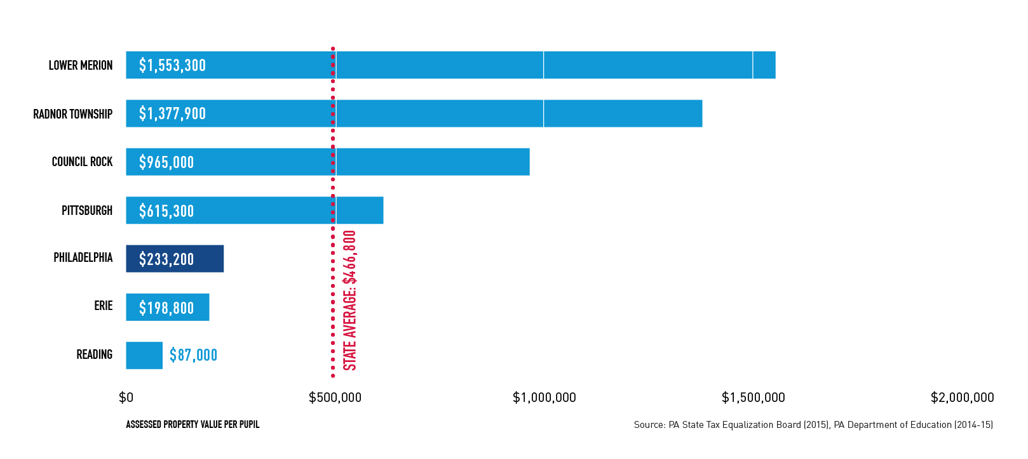
Low rents = diminished real estate values
= inadequate funding for schools

Slide 50

Good News: Downtown Living

Slide 51
Greater Center City is the fastest growing residential section of Philadelphia

Slide 52

Population up 19% since 2000 = 188,000
25% of those who moved to PHL between 2000-2015 moved to downtown

Slide 53
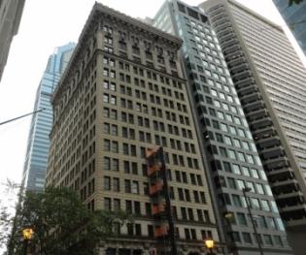
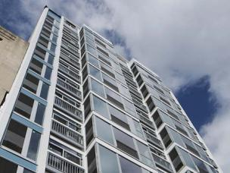
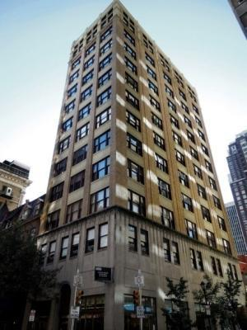
2,506 new units completed in 2016

Slide 54
20,725 completed since 2000

Slide 55
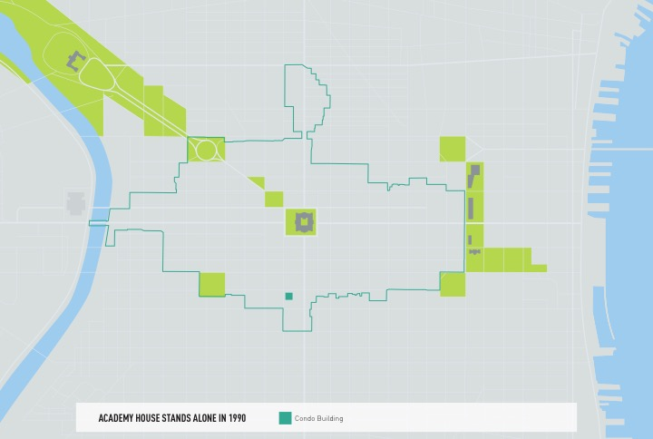

Slide 56

26 condos 50 units or more

Slide 57

50 units or more

Slide 58

50 units or more

Slide 59
Through the end of 2016 rents were steadily rising

Slide 60
Rising housing values:
Appreciation 6%/year since 2000
Greater Center City market has fully rebounded & substantially surpassed levels prior to the Great Recession

Slide 61

Diverse population; affordable housing

Slide 62



40% of downtown population 20-34 years of age
Large cohort of empty nesters

Slide 63

Very positive momentum, visible everyday

Slide 64

33,471 children born to Center City parents since 2000

Slide 65

76% of attending public schools in Center City

Slide 66

42% of employed CC residents work downtown; another 12% commute to University City.

Slide 67



62% of residents get to work without a car;
39% in core walk to work

Slide 68
Living at 10 times the density of suburban averages

Slide 69




Helping drive restaurants, retail & sidewalk vitality

Slide 70

Transformation & revival West Chestnut Street

Slide 71

Recovery on East Chestnut Street

Slide 72

Long awaited rebirth of Market East: 2017

Slide 73

Large-scale transformation of Gallery

Slide 74

Into the Fashion Outlets of Philadelphia in 2018

Slide 75




Continuous growth in fine dining restaurants
400
464
65 in 1992
350
300
2005 2010 2016

Slide 76
431 outdoor seating locations summer of 2016

Slide 77
New tenants entering the market across Center City

Slide 78

Center City today is rich with cultural amenities
Arts, Culture
& Civic Life

Slide 79

419 institutions spread throughout downtown

Slide 80


These amenities combine to attract the highest concentration of educated workers in city & region
30% have advanced degrees

Slide 81







Knowledge workers drive the new economy

Slide 82




Suburban firms are locating downtown to be near talent & start-ups

Slide 83

Very positive trend

Slide 84
Coworking spaces are both incubators for start-ups
A way for suburban firms to test the market

Slide 85

Significantly expanded business attraction resources on CCD/CPDC’s website

Slide 86



Direct links to all the State, City & PIDC’s incentive programs
& to all private sector organizations

Slide 87

Links to all resources for start-ups

Slide 88

Links to all coworking spaces

Slide 89
Challenges to overcome, but major opportunities
To attract more businesses downtown
Panel Discussion
Lisha Davis, Innovation Strategy, Vanguard
John Grady, President, PIDC
Wayne L. Fisher, Ex Managing Director, Newmark Grubb Knight Frank

